Slide 1
Recommendation System

Slide 2


Entitlement 1
Entitlement 2
Entitlement 3
Entitlement 4
…
Entitlement k
Entitlements Filtering
Candidate Entitlements
Ranking Service
New Hire
Prediction pipeline

Slide 3
Raw Data
Entitlement 1
Entitlement 2
Entitlement 3
Entitlement 4
…
Entitlement k
Entitlements Filtering
Candidate Entitlements
Ranking Service
New Hire
Trained ML model
Prediction pipeline

Slide 4
Raw Data
Entitlement 1
Entitlement 2
Entitlement 3
Entitlement 4
…
Entitlement k
Entitlements Filtering
Candidate Entitlements
Ranking Service
New Hire
Trained ML model
Rule
Prediction pipeline

Slide 5
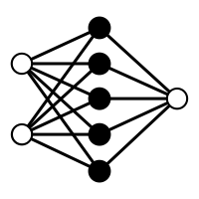
Raw Data
Entitlement 1
Entitlement 2
Entitlement 3
Entitlement 4
…
Entitlement k
Entitlements Filtering
Candidate Entitlements
Ranking Service
New Hire
Trained ML model
Prediction pipeline

Slide 6
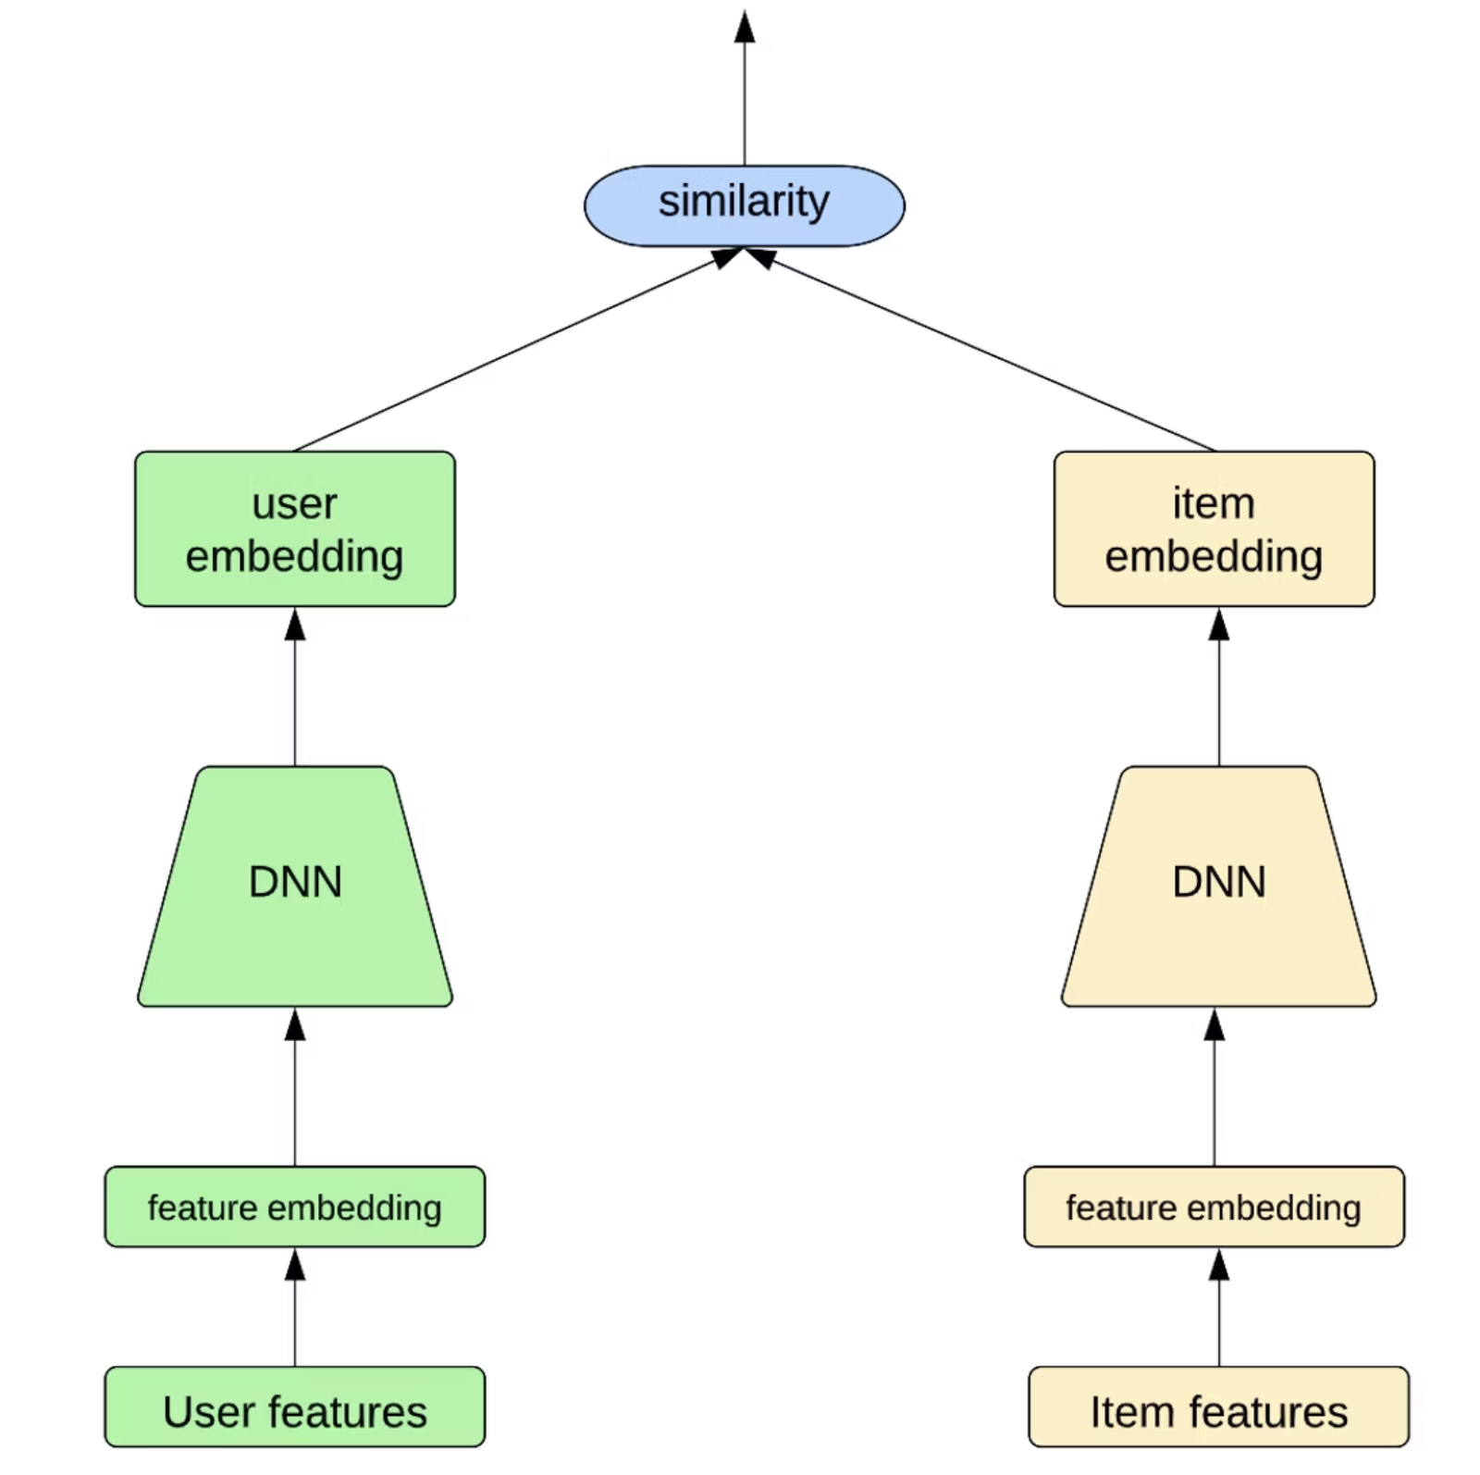

Slide 7
Label
Two-Tower NN
Cross-Entropy
Dot Product
User Embedding
Entitlement Embedding
User Encoder (DNN)
Entitlement Encoder (DNN)
User Features
Entitlement Features

Slide 8
User Features
Concatenated Features
0.6
1
0.4
0.2
0.3
0
1
0
0
0
0.9
1
0.1
0.3
0.2
0.1
0.7
0.1
0.6
1
0.3
0.2
1
0.5
0.1
0.3
0.7
0.3
0.5
0.4
1
0.2
Embedding
Embedding
CBOW
One hot
Embedding
Embedding
Pre-Trained BERT
SID
SSID
Title
LOB
City
Dept.
Job Description

Slide 9
Entitlement Features
Concatenated Features
0.6
1
0.4
0.2
0.3
0.9
1
0.1
0.3
0.2
0.3
0.2
1
0.5
0.1
0.3
0.7
0.3
Embedding
CBOW
Embedding
Pre-Trained BERT
ID
Entitlement Name
Entitlement Created TS
Entitlement Description

Slide 10
https://vinay-bhupalam.medium.com/personalized-recommendation-systems-c6a2159445b9
https://www.uber.com/blog/innovative-recommendation-applications-using-two-tower-embeddings/
https://www.linkedin.com/pulse/personalized-recommendations-iv-two-tower-models-gaurav-chakravorty/
https://dlp-kdd.github.io/assets/pdf/DLP-KDD_2021_paper_4.pdf
https://eng.snap.com/embedding-based-retrieval
https://recsysml.substack.com/p/recommendations-using-graph-neural
https://towardsdatascience.com/introduction-to-recommender-systems-2-deep-neural-network-based-recommendation-systems-4e4484e64746
https://developer.nvidia.com/blog/using-neural-networks-for-your-recommender-system/

